Slide 1
Fixed-Window Feedforward Language Models
CSCI 601-471/671 (NLP: Self-Supervised Models)
https://self-supervised.cs.jhu.edu/sp2024/

Slide 2
Logistics
HW2 grades are up!
Min: ?
Max ?
Median: ?
HW4 is released!
Please continue to give us feedback if you see any potential typos, odd phrasings, etc.

Slide 3
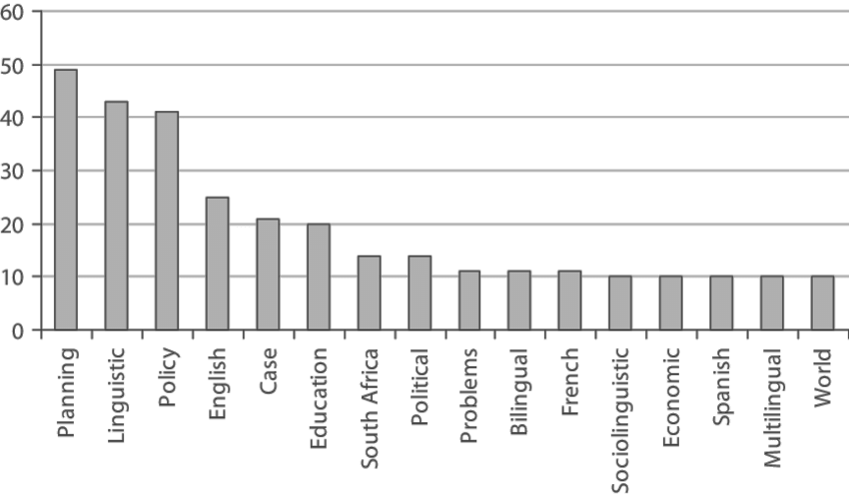
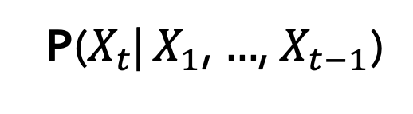
Recap: LMs
next word
context
P($X_{t}$| $X_{1}$, $…$, $X_{t−1}$)
Directly we train models on “conditionals”:
Prob
mat
table
bed
desk
chair
Some model
“The cat sat on the [MASK]”

Slide 4
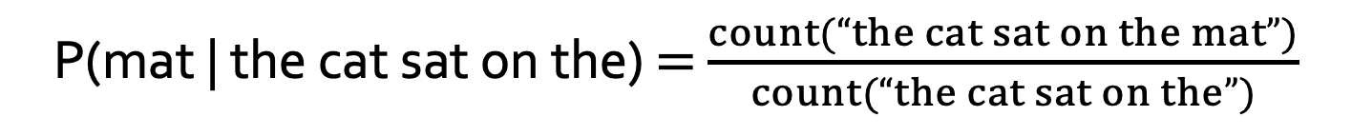
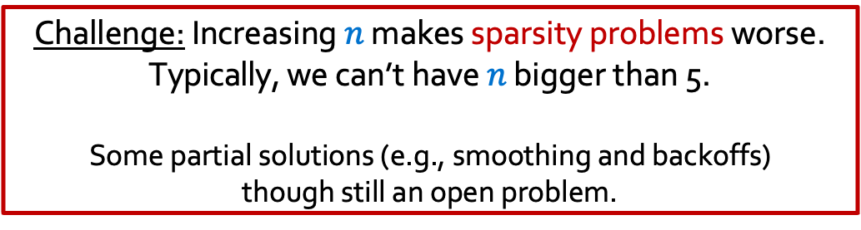
Recap: Counting
next word
context
P($X_{t}$| $X_{1}$, $…$, $X_{t−1}$)
How do we estimate these probabilities?
Let’s just count!
P(mat | the cat sat on the) $=$ $\frac{count(“the cat sat on the mat”)}{count(“the cat sat on the”)}$
Challenge: Increasing $n$ makes sparsity problems worse.
Typically, we can’t have $n$ bigger than 5.
Some partial solutions (e.g., smoothing and backoffs) though still an open problem.
Notes:
This is, in fact, fundamentally what autoregressive models do. Given a sequence, which here we are calling y_1, y_2, ... and so on, an autoregressive model tries to predict y_t from all of the sequence entries before y_t.

Slide 5
Recap Summary
Language Models (LM): distributions over language
N-gram: language modeling via counting
Challenge with large N’s: sparsity problem — many zero counts/probs.
Challenge with small N’s: not very informative and lack of long-range dependencies.

Slide 6
Chapter Plan
Language Modeling with feed-forward networks

Slide 7
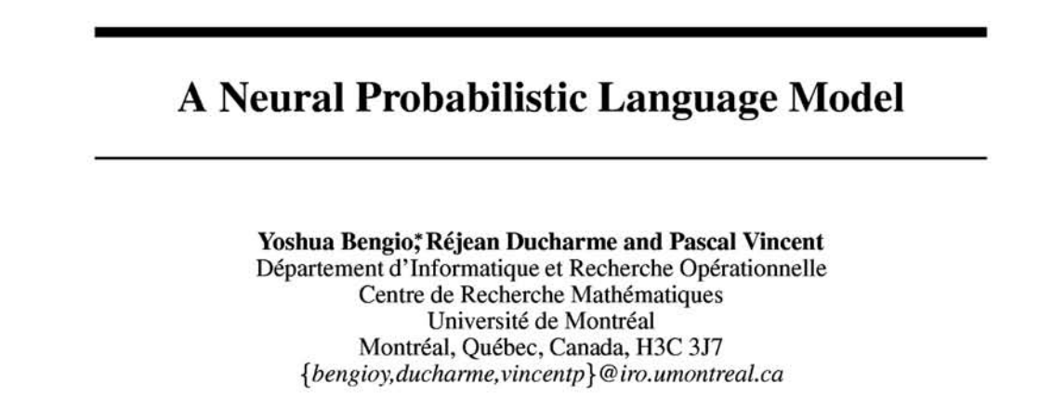
From Counting (N-Gram) to Neural Models
Probabilistic n-gram models of text generation [Jelinek+ 1980’s, …]
Applications: Speech Recognition, Machine Translation
“Shallow” statistical/neural language models (2000’s) [Bengio+ 1999 & 2001, …]
NeurIPS 2000

Slide 8
A Fixed-Window Neural LM
Given the embeddings of the context, predict the word on the right side.
Dropping the right context for simplicity -- not a fundamental limitation.
and
our
problems
turning
into
context words in window of size 4 target word

Slide 9
A Fixed-Window Neural LM
Given the embeddings of the context, predict the word on the right side.
Dropping the right context for simplicity -- not a fundamental limitation.
Discard anything beyond its context window
blah blah blah blah
and
our
problems
turning
into
discard
context words in window of size 4 target word

Slide 10
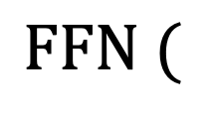
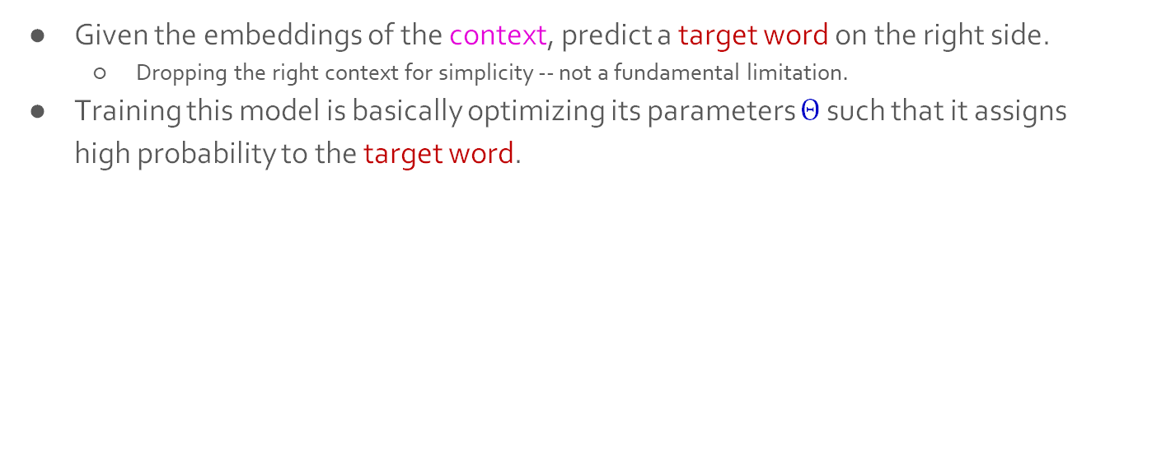
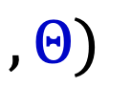
A Fixed-Window Neural LM
Given the embeddings of the context, predict a target word on the right side.
Dropping the right context for simplicity -- not a fundamental limitation.
Training this model is basically optimizing its parameters $Θ$ such that it assigns high probability to the target word.
Probs over vocabulary
Trainable parameters of neural network
mat
table
into
ant
chair
$$FFN ($$
$$, Θ)$$
O O O
O O O
O O O
O O O
lookup embeddings
and
our
problems
turning
into
context words in window of size 4 target word
[Bengio et al. 2003]

Slide 11
A Fixed-Window Neural LM
This is actually a pretty good model!
It will also lay the foundation for the future models (e.g., transformers, ...)
But first we need to figure out how to train neural networks!
Probs over vocabulary
Trainable parameters of neural network
mat
table
into
ant
chair
$$FFN ($$
$$, Θ)$$
O O O
O O O
O O O
O O O
lookup embeddings
and
our
problems
turning
into
context words in window of size 4 target word
[Bengio et al. 2003]

Slide 12
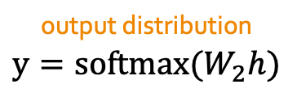
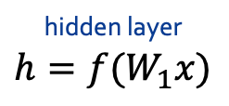
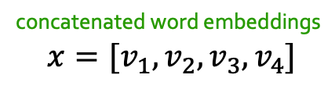
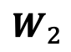
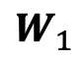
A Fixed-Window Neural LM
Prob
output distribution
$$y=softmax(W_{2}h)$$
mat
table
bed
desk
chair
Softmax
$$W_{2}$$
hidden layer
$$h=f(W_{1}x)$$
O O O O O O O O O O O O O O O
$$W_{1}$$
concatenate
concatenated word embeddings
$$x=[v_{1}, v_{2}, v_{3}, v_{4}]$$
O O O
O O O
O O O
O O O
lookup embeddings
and
our
problems
turning
into
context words in window of size 4 target word
[Bengio et al. 2003]

Slide 13
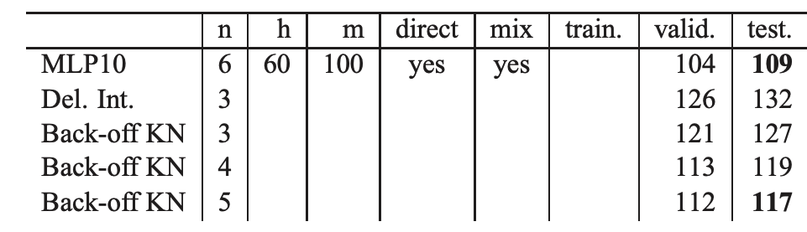
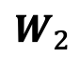
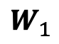
A Fixed-Window Neural LM: Compared to N-Grams
Prob
mat
table
bed
desk
chair
Softmax
Improvements over n-gram LM:
Tackles the sparsity problem
Model size is O(n) not O(exp(n)) — n being the window size.
$$W_{2}$$
O O O O O O O O O O O O O O O
$$W_{1}$$
concatenate
O O O
O O O
O O O
O O O
lookup embeddings
and
our
problems
turning
into
context words in window of size 4 target word
[Bengio et al. 2003, notes from Richard Socher]

Slide 14
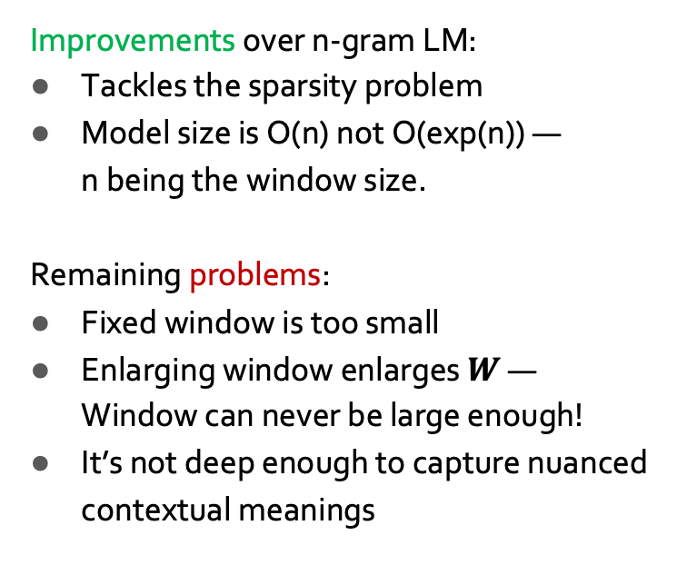
A Fixed-Window Neural LM: Compared to N-Grams
Prob
mat
table
bed
desk
chair
Softmax
Improvements over n-gram LM:
Tackles the sparsity problem
Model size is O(n) not O(exp(n)) — n being the window size.
Remaining problems:
Fixed window is too small
Enlarging window enlarges $W$ — Window can never be large enough!
It’s not deep enough to capture nuanced contextual meanings
$$W_{2}$$
O O O O O O O O O O O O O O O
$$W_{1}$$
concatenate
O O O
O O O
O O O
O O O
lookup embeddings
and
our
problems
turning
into
context words in window of size 4 target word
[Bengio et al. 2003, notes from Richard Socher]

Slide 15
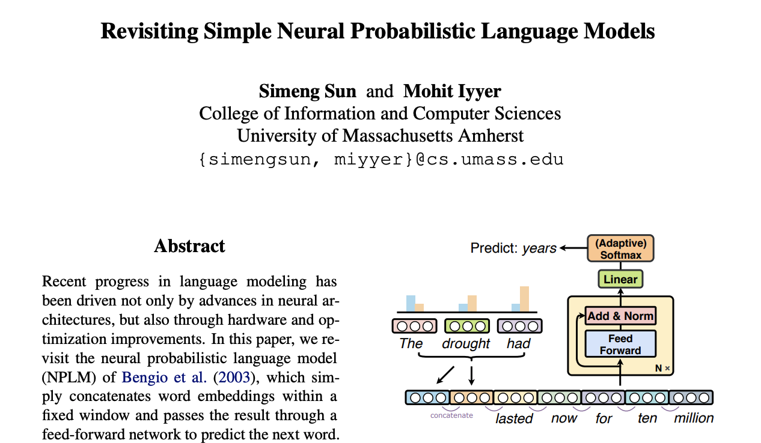
A Fixed-Window Neural LM: Going Deeper

Slide 16
Prob
Softmax
mat
table
bed
desk
chair
Add & Norm
Linear
Feed-Forward layer
xN
Add & Norm
Feed-Forward layer
Add & Norm
concatenate
Feed-Forward layer
N layers
O O O
O O O
O O O
O O O
lookup embeddings
Add & Norm
and
our
problems
turning
into
Feed-Forward layer
context words in window of size 4 target word
[Sun and Iyyer 2021]

Slide 17
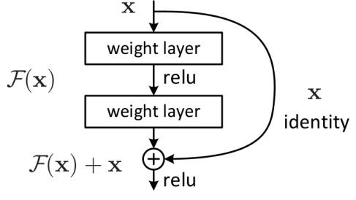
Prob
Softmax
mat
table
bed
desk
chair
Linear
xN
Add & Norm
Feed-Forward layer
Uses residual connections (He et al. 2016) — “information highways” between layers. (we saw them in the earlier chapter)
concatenate
O O O
O O O
O O O
O O O
lookup embeddings
and
our
problems
turning
into
context words in window of size 4 target word
[Sun and Iyyer 2021]

Slide 18
Prob
Softmax
mat
table
bed
desk
chair
Linear
xN
Add & Norm
Feed-Forward layer
Uses layer normalization (Ba et al. 2016) which reduces variance across different data/batches and makes the optimization easier/faster.
concatenate
O O O
O O O
O O O
O O O
lookup embeddings
and
our
problems
turning
into
context words in window of size 4 target word
[Sun and Iyyer 2021]

Slide 19
Prob
Softmax
mat
table
bed
desk
chair
Linear
xN
Use “dropout” to avoid overfitting.
Add & Norm
Feed-Forward layer
concatenate
Use ADAM optimizer (Kingma & Ba, 2017), a variant of Stochastic Gradient Descent.
O O O
O O O
O O O
O O O
lookup embeddings
and
our
problems
turning
into
context words in window of size 4 target word
[Sun and Iyyer 2021]

Slide 20
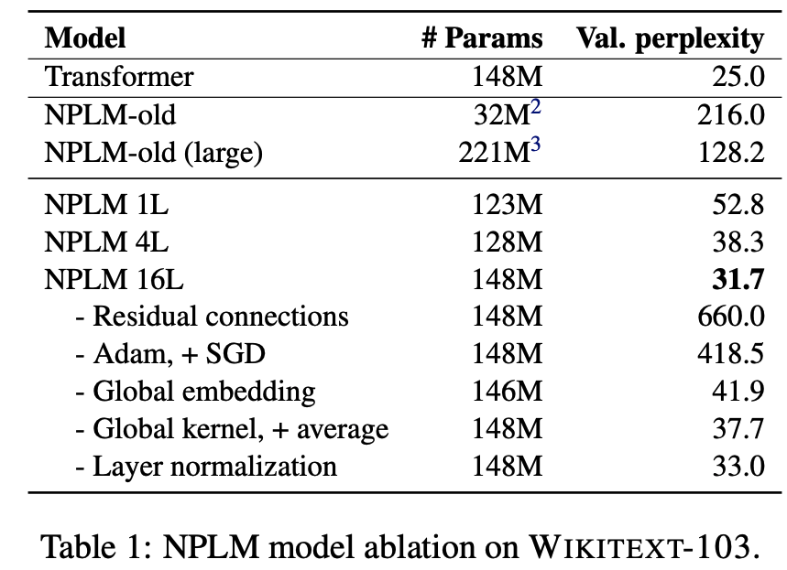
Prob
Softmax
mat
table
bed
desk
chair
Linear
xN
Add & Norm
Feed-Forward layer
concatenate
O O O
O O O
O O O
O O O
Takeaways:
Depth helps
Residual connections are important
Adam works (here) better than SGD
lookup embeddings
and
our
problems
turning
into
context words in window of size 4 target word
[Sun and Iyyer 2021]

Slide 21
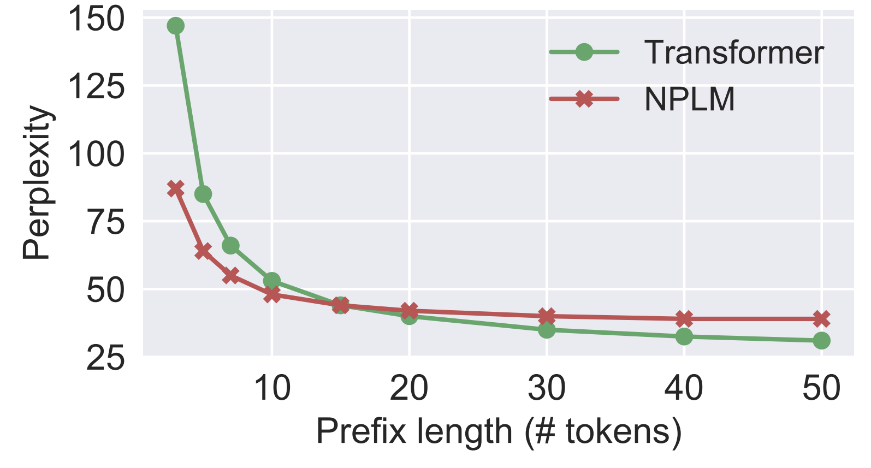
Effect of window size:
Fixed-WindowLM (NPLM) is better than the Transformer (will see them in 2 weeks!) with short prefixes but worse on longer ones.
Prob
Softmax
mat
table
bed
desk
chair
Linear
xN
Add & Norm
Feed-Forward layer
concatenate
O O O
O O O
O O O
O O O
lookup embeddings
and
our
problems
turning
into
context words in window of size 4 target word
[Sun and Iyyer 2021]

Slide 22
Fixed-Window LM in Practice
Fixed-Window LM trained on Wikipedia:
TBD

Slide 23
positive or negative
We can use the parameters this pre-trained model as initialization for a classifier.
For example, a classifier for mapping movie reviews to their sentiments.
Challenge: how to handle long sentences?
Repeated use of this classifier on moving window
More principled approaches later
Softmax
Linear
xN
Add & Norm
Feed-Forward layer
concatenate
O O O
O O O
O O O
O O O
lookup embeddings
and
our
problems
turning
movie reviews

Slide 24
Summary
Language Modeling (LM), a useful predictive objective for language
Perplexity, a measure of an LM’s predictive ability
N-gram models (~1980 to early 2000’s),
Early instances of LMs
Difficult to scale to large window sizes
FFN-LMs (early and mid-2000’s ),
Effective predictive models based on feed-forward networks
Difficulty in long-range dependencies

Slide 25
What Changed from N-Gram LMs to Neural LMs?
What is the source of Neural LM’s strength?
Why sparsity is less of an issue for Neural LMs?
Answer: In n-grams, we treat all prefixes independently of each other! (even those that are semantically similar)
students opened their ___
pupils opened their ___
scholars opened their ___
undergraduates opened their ___
students turned the pages of their ___ students attentively perused their ___
...
Neural LMs are able to share information across these semantically-similar prefixes and overcome the sparsity issue.

Slide 26
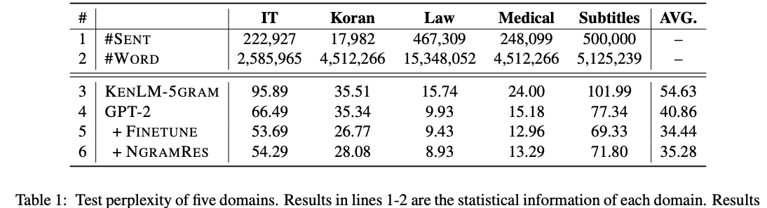
Best of both worlds
n-grams are easy to compute for small ”n”.
Why waste energy to make neural-LMs [re]learn these statistics?
Li et al. 2022 propose learning neural LMs to fits the residual between an n-gram LM and real-data distribution.
Allows the neural part to focus on the deeper understanding of language.
[N-gram Is Back: Residual Learning of Neural Text Generation with n-gram Language Model, Li et al. 2022]

Slide 27
Summary Thus Far
Language Models (LM): distributions over language
N-gram: language modeling via counting
Neural Language Models: neural networks trained with LM objective
Fixed-window Neural LM: first of many LMs we will see in this class
Key question: how to better capture long-range dependencies?

Slide 28
Summary
Language Models (LM): distributions over language
N-gram: language modeling via counting
Neural Language Models: neural networks trained with LM objective
Fixed-window Neural LM: first of many LMs we will see in this class

Slide 29
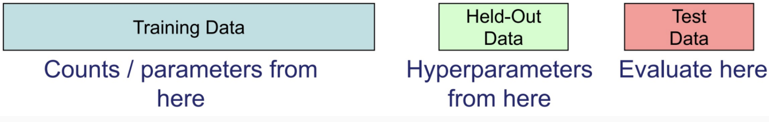
Evaluating Language Models
Setup:
Train it on a suitable training documents.
Evaluate their predictions on different, unseen documents.
An evaluation metric tells us how well our model does on the test set.

Slide 30


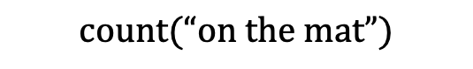
Evaluating Language Models: Example
Setup:
Train it on a suitable training documents.
Evaluate their predictions on different, unseen documents.
An evaluation metric tells us how well our model does on the test set.
Example: I use a bunch of New York Times articles to build a bigram probability table
A good language model should assign a high probability to held-out text!
Now I’m going to evaluate the probability of some heldout
data using our bigram table
train
eval
$$count(“on the mat”)$$

Slide 31
Be Careful About Data Leakage!
Advice from a grandpa👴:
- Don’t allow test sentences leak into training set.
- Otherwise, you will assign it an artificially high probability (=cheating).
Example: I use a bunch of New York Times articles to build a bigram probability table
A good language model should assign a high probability to held-out text!
Now I’m going to evaluate the probability of some heldout
data using our bigram table
train
eval
$$count(“on the mat”)$$

Slide 32

Evaluating Language Models: Intrinsic vs Extrinsic
Intrinsic: measure how good we are at modeling language
Extrinsic: build a new language model, use it for some task (MT, ASR, etc.)
Example: I use a bunch of New York Times articles to build a bigram probability table
Now I’m going to evaluate the probability of some heldout
data using our bigram table
extrinsic eval
train
eval
$$count(“on the mat”)$$

Slide 33
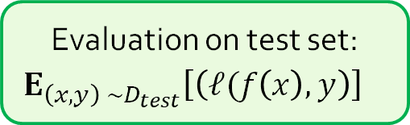
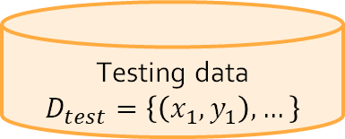
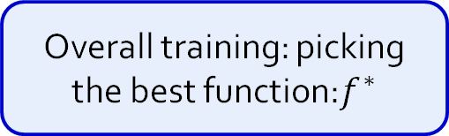
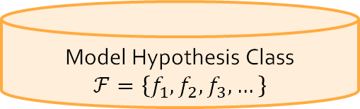
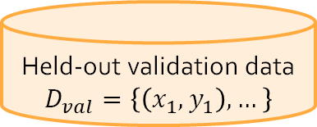
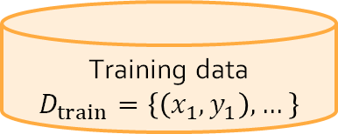
A Typical Machine Learning and Evaluation Protocol
Each choice of parameters in neural networks correspond to another function.
Model Hypothesis Class
$$ℱ=\left\{f_{1},f_{2},f_{3},…\right\}$$
Training data
$$D_{train}=\left\{\left(x_{1},y_{1}\right), …\right\}$$
Overall training: picking the best function:$f^{∗}$
Training is to pick the function given the observed data.
Held-out validation data
$$D_{val}=\left\{\left(x_{1},y_{1}\right), …\right\}$$
Testing is t predict the quality of the best selected function
Testing data
$$D_{test}=\left\{\left(x_{1},y_{1}\right), …\right\}$$
Evaluation on test set:
$${E_{\left(x, y\right) \sim D_{test}}\left[\left(ℓ(f\left(x\right),y\right)\right]}^{}$$

Slide 34
PyTorch Recap:
Implementing a Feedforward LM

Slide 35
TODO

